Slide 1


Team 63: AWG
Bi-Weekly Update 2 Leandro Bracho, Nick Joseph, Oscar Medrano, Robin Smithson Sponsor: Dr. John Lusher TA: Zhewen Hu
Notes:
Intro should take 30 seconds

Slide 2
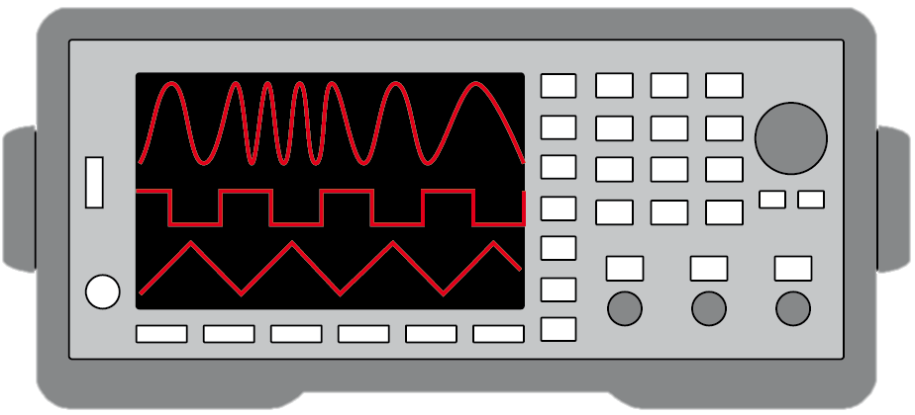
Project Summary
Problem Statement:
Test validation is a vital step in the design and fabrication of circuit boards for any project in the realm of electrical engineering.
Typical AWGs can be large and unintuitive
Solution Proposal:
Create a mobile user interface for the AWG
Bluetooth connection
Voltage range of +/- 10 V
Frequency between 1 Hz – 20 kHz
Maximum of 65,535 data points
Allow hand drawn waveforms
Notes:
(30 seconds)
Robin

Slide 3
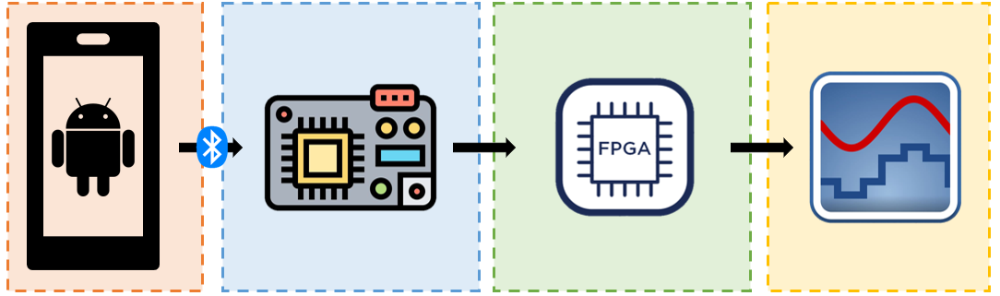
Project/Subsystem Overview
Diagram showing subsystems – with labels showing subsystem owners
Leandro Bracho | Robin Smithson | Nick Joseph | Oscar Medrano
Android Application | Microcontroller | FPGA | DAC
Notes:
(45 seconds)
Robin

Slide 4
Project Timeline
Update PCBs from feedback from last semester (completed 1/29) | Revalidate & Assess Subsystems (completed 2/5) | Order New PCBs (to complete by 2/16) | Integration of Subsystems (to complete by 2/29) | 3D Print Housing & Installation (to complete by 3/25) | Test & Validation (to complete by 4/22) | Demo and Report (to complete by 4/29)
Notes:
(30 seconds) Leandro
-- Save discussion for subsystem update
-- Save detail for execution plan & validation plan status

Slide 5
Android Application
Leandro Bracho
Accomplishments since Update 1 24 hrs of effort | Ongoing progress/problems and plans until the next presentation
Enable Device Discovery Consistent Pairing Connection to MCU | Transfer Data to MCU Improve Bluetooth GUI
Notes:
** Leandro ** (45 Seconds)
For 2nd review should all be in the context of your integration plans! For example:
“Completed X-function in preparation for integrating with Y-subsystem”
“Tested integrated motor controllers with MCU by verifying full range of motion on all 6 joints with no load and 0.5kg load”
“On-going integration of motor control system with MCU”
“By next review will integrate with android app”

Slide 6
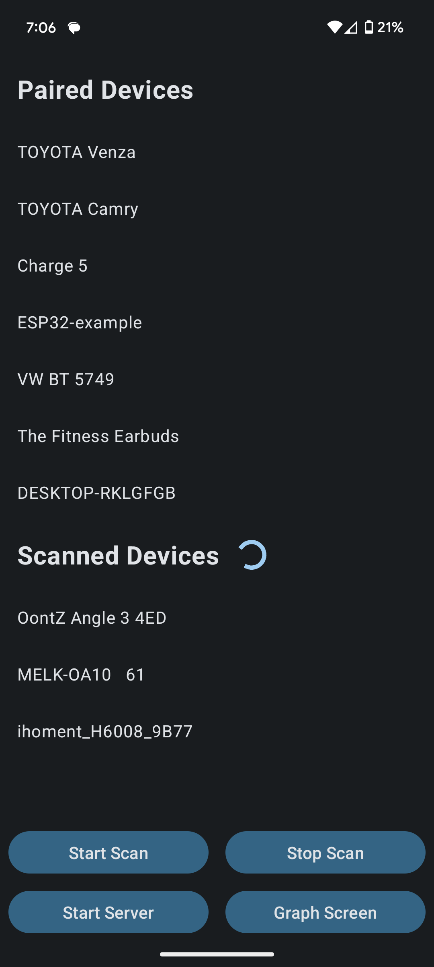
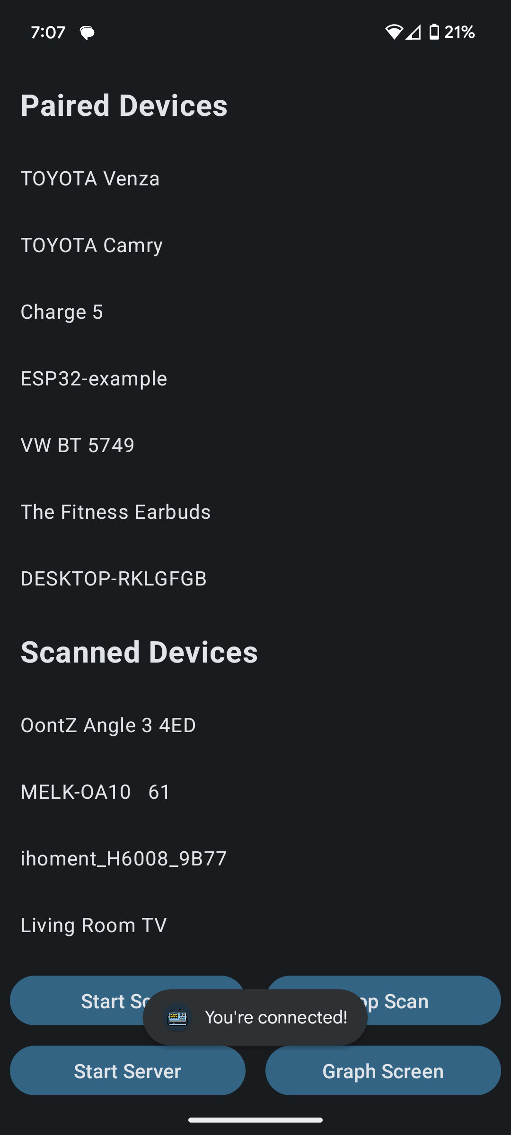
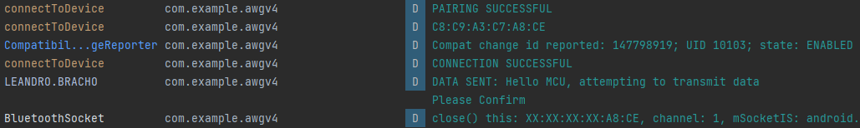
Android Application
Leandro Bracho
Android Studio Log Output
Bluetooth Scan
Connection Attempt
Notes:
** Leandro ** (45 Seconds)
Interesting figure related to your subsystem progress ---
Best to show:
Results from prep for integration => integration => test of integrated subsystems

Slide 7
MCU Robin Smithson
Accomplishments since Update 1 15 hrs of effort | Ongoing progress/problems and plans until the next presentation
Pairing & Connection with Android app achieved App is client, MCU is server PCB Reviewed | Import data from app to MCU Program to export data to FPGA Implement mounting holes & order PCB Unable to program Bluetooth connection on PCB from 403 (using devkit)
Notes:
(45 seconds)

Slide 8
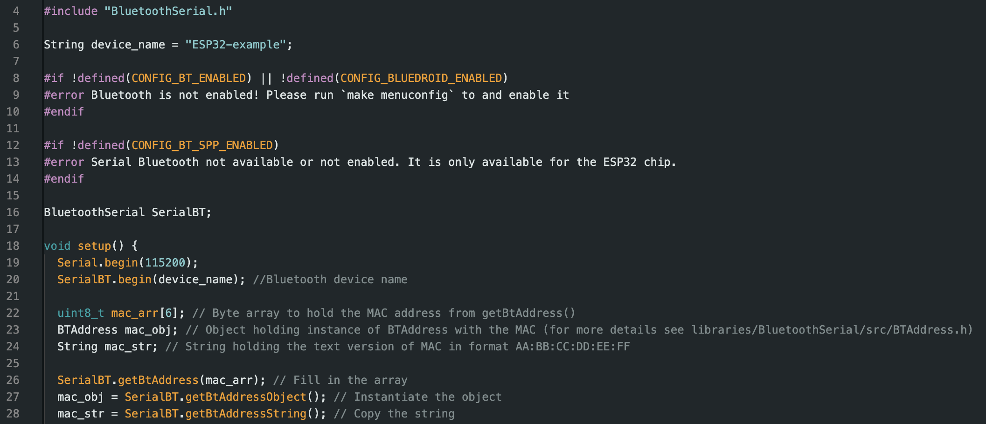
MCU Robin Smithson
Bluetooth Classic Pairing & Connection Code
Notes:
(45 seconds)
Interesting figure related to your subsystem progress ---
Best to show:
Results from prep for integration => integration => test of integrated subsystems

Slide 9
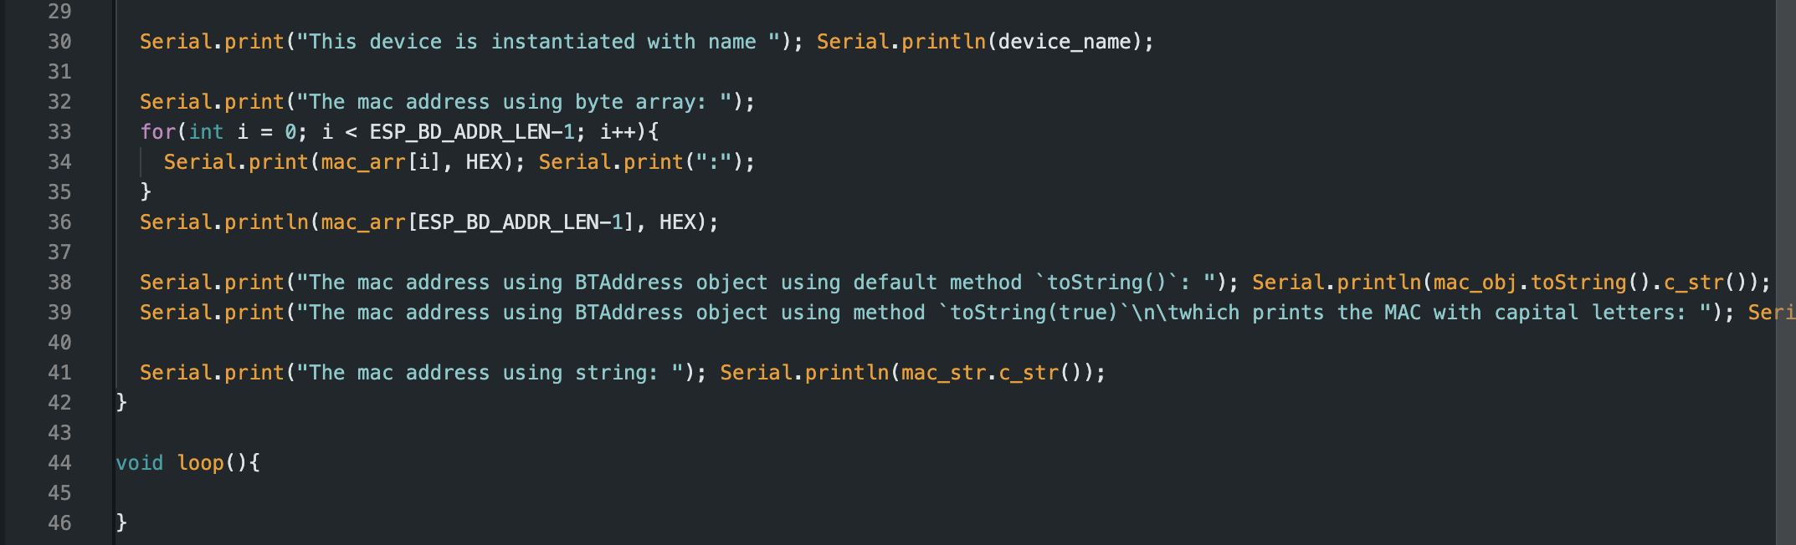
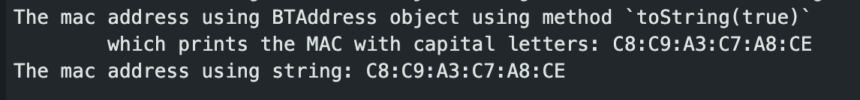
MCU Robin Smithson
Bluetooth Classic Pairing & Connection Code Cont’d
Output
Notes:
(45 seconds)
Interesting figure related to your subsystem progress ---
Best to show:
Results from prep for integration => integration => test of integrated subsystems

Slide 10
FPGA Nick Joseph
Accomplishments since Update 1 12 hrs of effort | Ongoing progress/problems and plans until the next presentation
Finished updating the schematic Most of the PCB is wired | PCB design will be finished by Friday. Have PCB entirely soldered Begin testing connections with the MCU and the DAC

Slide 11
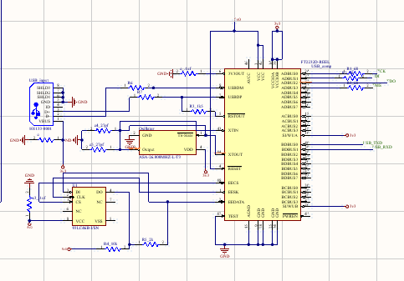
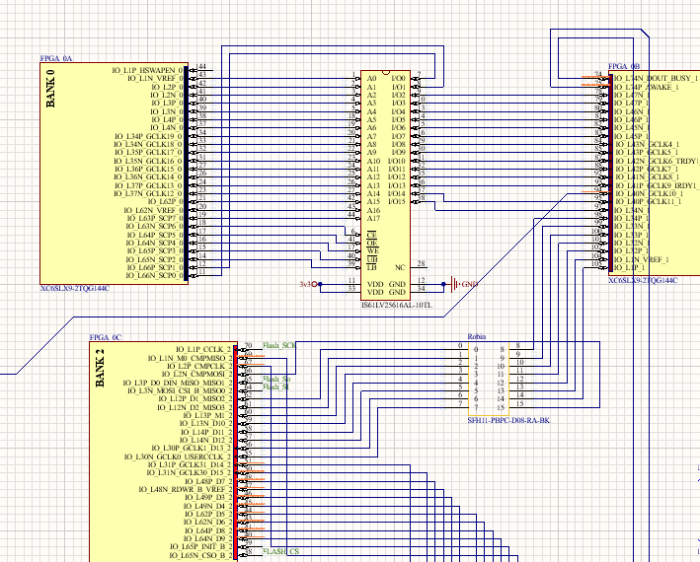
FPGA
Nick Joseph
Circuit Schematics

Slide 12
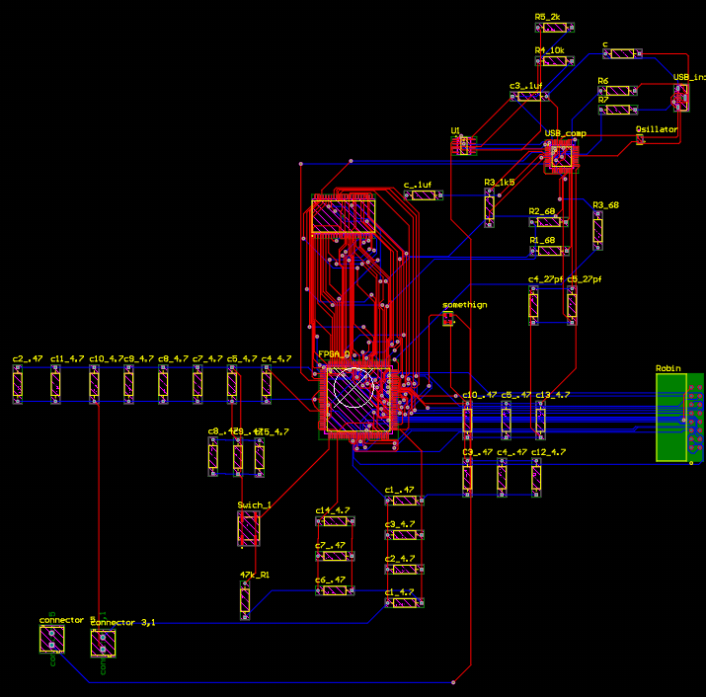
FPGA
Nick Joseph
PCB Design

Slide 13
DAC Circuitry
Oscar Medrano
Accomplishments since Update 1 5 hrs of effort | Ongoing progress/problems and plans until the next presentation
Have the connectors that will be used to integrate with the FPGA subsystem | Need to make the connector footprint. Routing the PCB Ordering PCB Solder Components Testing PCB

Slide 14
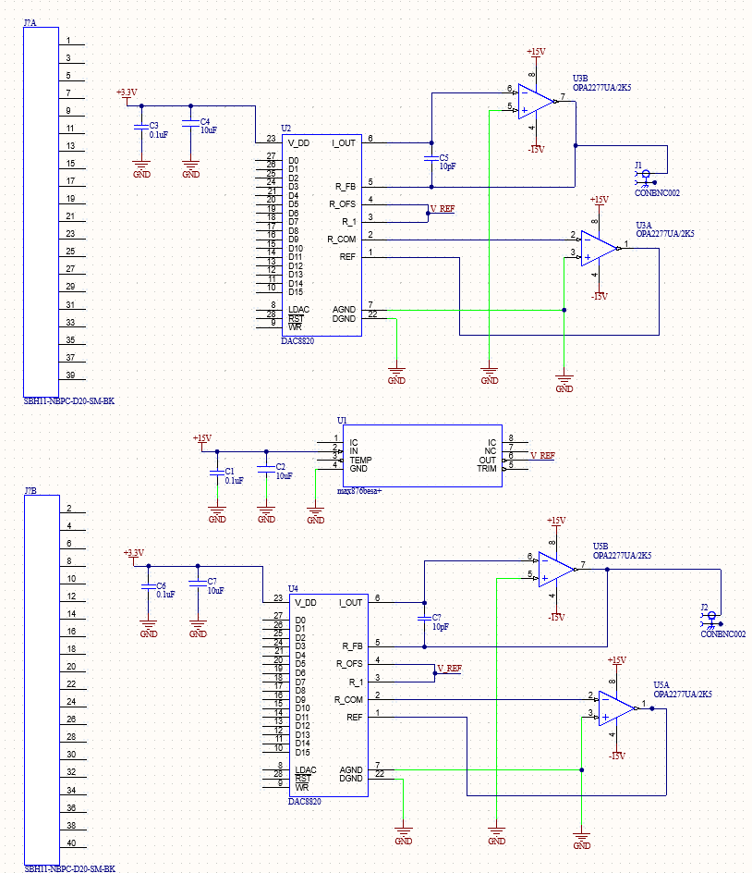
DAC Circuitry
Oscar Medrano
Circuit Schematic

Slide 15
Power System
Oscar Medrano
Accomplishments since Update 1 8 hrs of effort | Ongoing progress/problems and plans until the next presentation
All DC-DC converters have been selected. | Order parts (DC-DC Converters, Capacitors, and Inductors) Designed for the wrong AC adapter

Slide 16
Execution Plan
 | Jan-22 | Jan-29 | Feb-5 | Feb-12 | Feb-19 | Feb-26 | Mar-4 | Mar-11 | Mar-18 | Mar-25 | Apr-1 | Apr-8 | Apr-15 | Apr-22 | Apr-29
Andriod Application
Assess Current Application Status |  |  |  |  |  |  |  |  |  |  |  |  |  |  |  |  | Not Started
Improve Bluetooth Scan |  |  |  |  |  |  |  |  |  |  |  |  |  |  |  |  | In Progress
Pair & Connect Via Bluetooth |  |  |  |  |  |  |  |  |  |  |  |  |  |  |  |  | Completed
Transfer Data Via Bluetooth |  |  |  |  |  |  |  |  |  |  |  |  |  |  |  |  | Behind Schedule
UI Improvements
Microcontroller
Edit MCU Schematic
Program Bluetooth Connection
Import Data
Export Data
FPGA
Redesign FPGA board
Solder New Board
Test System
First Integration
Fixing Integration Issues
DAC & Power System
Schematic Design (DAC)
Schematic Design (Power Sys)
Order New Parts
Solder Boards
Test DAC System
Test Power System
 | Jan-22 | Jan-29 | Feb-5 | Feb-12 | Feb-19 | Feb-26 | Mar-4 | Mar-11 | Mar-18 | Mar-25 | Apr-1 | Apr-8 | Apr-15 | Apr-22 | Apr-29
Project Introduction Presentation
Project Update (1) Presentation
Project Update (2) Presentation
Project Update (3) Presentation
Project Update (4) Presentation
Final Presentation
Project Demo
Final Report
Integration
Power System Designed
App and MCU Connection
Complete PCB Schematic
Final PCBs Ordered
Parts Still Needed Ordered
Final PCBs Soldered
Debugging and Testing
Final System Adjustments
Notes:
Michelle

Slide 17
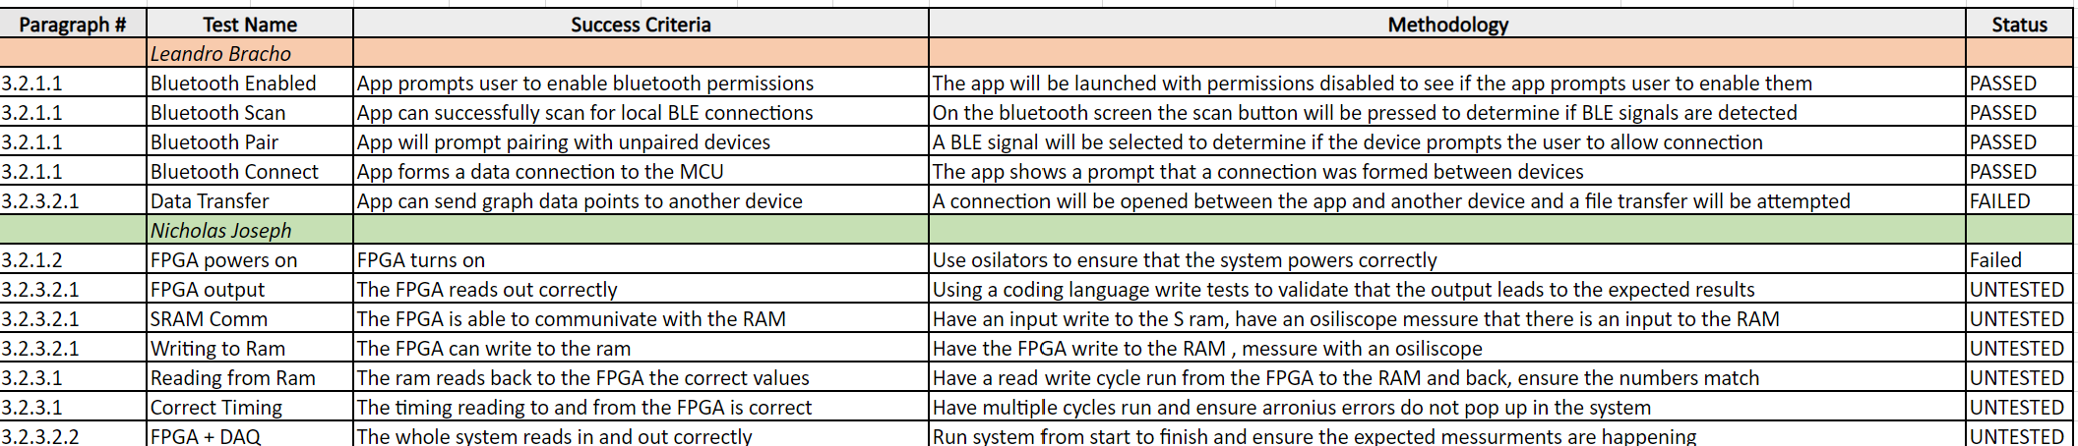
Validation Plan
Notes:
Michelle

Slide 18
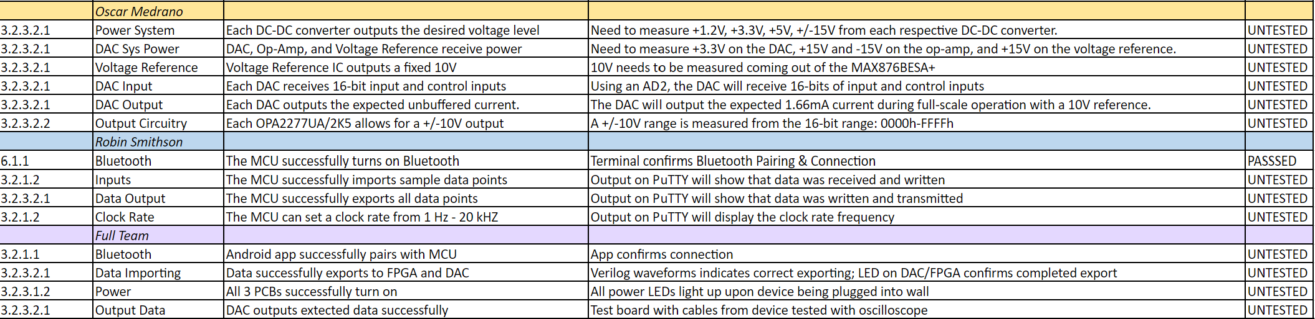
Validation Plan
Notes:
Michelle

Slide 19
Thank you

